Slide 1
Session 6.2 Performance 1 – Physical Design
IN705 Databases 3 - 2018
Notes:
Today we will talk about what we must consider wrt the physical layout of the database on disk
Next time we talk about query optimisation.

Slide 2
Life Cycle
Requirements Elicitation
Conceptual Model
Logical Model
Physical Design
Notes:
Although your logical model produced tables and columns and keys, that’s not the end of the decisions that must be made
In the process of actually implementing a particular database for a particular client, there are choices
The same logical model can end up very differently, depending on the situation.

Slide 3
Issues
DBMS
Available hardware
Amount of data
Distribution of values within the data
Required performance specifications
Patterns of data access & modification
Notes:
Many situation-specific issues will effect the final implementation of your database, as shown here....
So at one installation you might have a lot of swoopy hardware; at another, barely enough to get by
One installation might have 1,000,000s of record, another only a fraction of that
Distribution of values: common queries returning many or few records?
One database might need very fast response time, but not require many modifications; another might not be mad about speed, but can’t ever be offline
And so on.
So, as is often the case, there is no single “best” solution to many of these physical design problems
Getting an acceptable solution requires a good understanding of both:
The underlying principles
The specific context of operation

Slide 4
Impact
During physical design, actions are taken which extend, or even modify the logical model.
Actions
Adding Indexes and Views
Distributing tables physically
Storing derived data
Combining tables
Denormalisation
Duplication
Notes:
The actions are listed in increasing order of their impact on the logical model
For example, adding an index or partitioning a table doesn’t change the relationship between the tables in the logical model and the physical tables on disk
By comparison, denormalisation will cause some tables in the logical model to disappear from the physical instantiation.
The most useful and powerful is the index, so we will look carefully at them today, but the others are important to understand as well.

Slide 5
Role of the DBMS
The DBMS you use will determine the specific tuning actions you can take.
But the principles are the same for all DBMSs
Notes:
For example, we will talk later about an important kind of index that isn’t supported in SQL Server
We are using MSSQL this term, so we won’t actually tune an Oracle database
However, you would like to be able to do so with just a little time and a manual, if anybody ever asks you to
Therefore, we will discuss the issues around physical design in as system-independent a way possible
Remember that all these things are covered on the theory exam.
During the DBA portion of the paper, we will look more closely at the specifics of tuning SQL Server

Slide 6
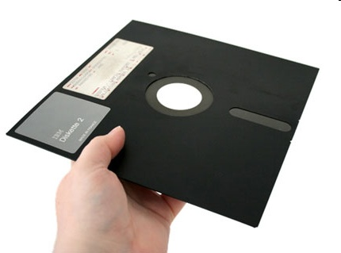
The Problem
Notes:
Physical design is largely about speed (also about security and reliability, but mostly about speed).
You need, therefore, to understand what thing or things impact database response time.
There are several things that can harm database performance.
For example, if two users want to change the same field at the same time, one of them has to wait.
This is a concurrency issue, and we will talk about it later on.
But the biggest, clumsiest, ugliest problem is hardware – specifically memory. Specifically, secondary memory.
The big bottleneck in any DBMS is the time it takes to get data from disk to RAM
(This is an 8 inch floppy. The ones I used in my first programming class held 64k. You kept an entire 10-week paper’s worth of code on them.)

Slide 7
Memory
Cache
RAM
Hard drive
Tape
SPEED
SIZE
Notes:
We review here very briefly the issues around memory.
As you know, there are different kinds of memory in/associated with your machine
The problem is that the fast memory is small, and the big memory is slow

Slide 8
The Problem
Cache
RAM
Hard drive
Tape
SPEED
SIZE
Notes:
We’re no going to worry about cache at the moment, as that is an operating system issue
We’re also not going to worry about tape at the moment, although we will talk about it when we discuss backups
So let’s just think about RAM and Disk
RAM is the memory that machine instructions can work on. For data to be used, it must be in RAM
Even a loaded machine probably tops out at about 16Gb of RAM, while it will have 100s of Gb of disk storage
For a database of any size, there is not enough room for the whole thing to sit in RAM
So to process the contents of the database, the system has to find the relevant portion on disk and move it into RAM.
If modifications are made in RAM, those data have to be written back out to disk
These disk accesses are the biggest bottleneck in database processing
A large element of physical design work is to arrange your database on disk so as to minimise the number of disk accesses required
(As we will see, we can also try to write our code with this goal in mind as well)
To understand how this arranging works, you need to remember how bits are stored on disk, and how they are accessed.
We review this briefly here

Slide 9
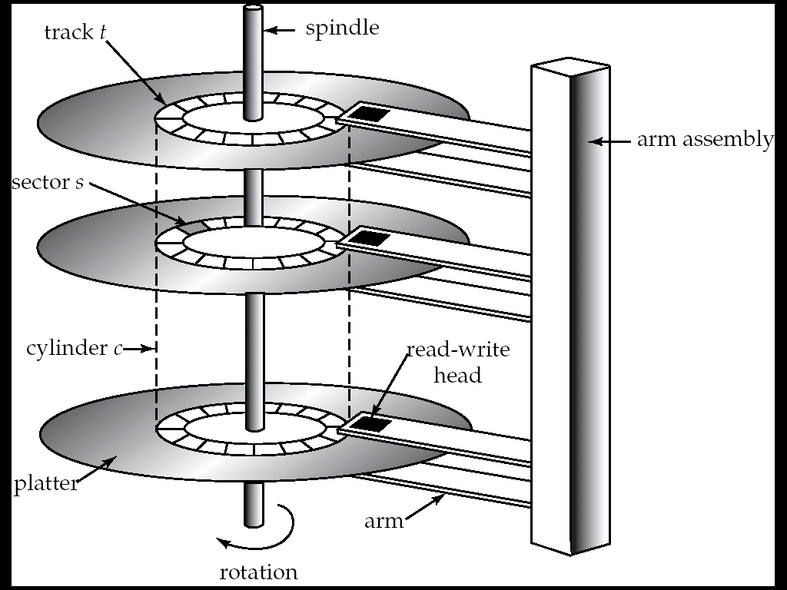
Magnetic Storage
From Silberschatz 2006
Notes:
A magnetic storage disk consists of a series of flat “platters”. These are coated with magic stuff that can hold 0s and 1s
Each platter is divided into a series of concentric “tracks” of increasing diameter from centre to edge
Each track is divided into a series of “sectors”. The sector is the smallest unit that can be read from the disk
The sectors themselves are organised into logical (not physical) groups called “blocks”. Data are transferred from disk to RAM in units of blocks
Bits are moved to and from the disk by positioning the read/write heads above the required track (seek time), and then waiting for the desired sector to rotate under the r/w head (rotational latency). This is the slowest part of the whole process.
That is, once you get the heads where they should be, data transfers fairly quickly compared to the time it takes to move the heads
Therefore, to get good database performance, you want to minimise the number of times you have to move the read/write heads.
Even from this vast simplification, you can see that how the records in your database are laid down on disk will effect performance.
For example, if a large set of records is often fetched together for processing, it will be quicker if those records are in adjacent blocks (either within the same track, or same cylinder).

Slide 10
Block Access Optimisation
Out of scope
Notes:
There are a number of operating system level strategies for block access optimisation.
Systems that defrag, for example, do so to keep logically adjacent blocks physically close together.
These issues are out of scope for this paper, as they are architecturally below the database level.
However, if you’re interested, I can provide further references.

Slide 11
File Organisation
A database file is logically a sequence of records
A database file is physically a sequence of blocks
Blocks are fixed size (a hardware property)
Records are variable sized
How do we map records to blocks for maximum access efficiency?
Notes:
However, very much a part of the DBMS business is the organisation of its files on disk.

Slide 12
Record Length
Fixed or Variable
Notes:
Tuples (records) from different tables are almost certainly going to be different sizes, but what about different tuples from the same table?
These can be either fixed length (all records in a table use the same number of bits) or variable length (different records in the same table use different numbers of bits) depending on the contents

Slide 13
Record Length
CREATE TABLE tblAccountInfo
(
accountID char(10),
branchName char(22),
balance numeric(12,2)
)
CREATE TABLE tblAccountInfo
(
accountID varchar(10),
branchName varchar(22),
balance numeric(12,2)
)
Notes:
Look at these two table definitions
What’s the difference?
In the first table, every record requires exactly the same number of bits, some of them will be blank; in the second, there are no blank bits and every record will be in length only that required to exactly hold the two string variables.
Variable length records complicated the storage of your database on disk.
So we will start by talking about how it works with fixed length records, and then consider the extensions required to accommodate data types like varchar

Slide 14
Fixed Length Records
CREATE TABLE tblAccountInfo
(
accountID char(10),
branchName char(22),
balance numeric(12,2)
)
Each char requires 1 byte
A numeric(12,2) requires 8 bytes
Each record in this table requires exactly 40 bytes.
How should we place these records in a disk block?
Notes:
Fixed length records

Slide 15
Fixed Length Records
Block i
Record 1
Record 2
Record 3
………….
Record n
40
80
120
(n-1) * 40
Block i
Record 1
Record 2
Record 3
………….
Partial Record n
40
80
120
< (n-1) * 40
Block i+1
Rest of Record n
Record n+1
Record 3
………….
<40
Notes:
One option is to just stuff them in end to end.
If the size of a block is a perfect multiple of 40, everything is fine
But what if the size of the block isn’t a perfect multiple of 40 (or however big your record is)?
At the ends of blocks, your records will get split up. Remember that we said that things that needed to be accessed together should be in the same block? Well, certainly all the bytes of a single record will need to be accessed together, and will thus need to be in the same block.
Therefore, it’s not done this way.

Slide 16
Fixed Length Records
Block i
Record 1
Record 2
Record 3
…….
Record n
Block i+1
Record n+1
Record n+2
Record n+3
…..
Record 2n
40
80
120
(n-1) * 40
Notes:
Like so (assume all those boxes were to scale…)
Just for interest, what happens here when a record is deleted?
You could shift all the other records back one (including reshuffling across block boundaries). Then everything would be tidy.
Is this a good idea?
No. Because of all the disk accesses that would be required.
The solution actually used is quite interesting. For an unsorted file (and most are), on the assumption that deletions are relatively infrequent in a database, empty spaces are often simply left in place (until some rare bulk tidy up operation during a system down time)
New records are inserted into these empty spaces as required. Think though about what a pain this would be to find an empty space? You would actually have to do a linear search through the whole file every time looking for empty spaces. This would require exactly the bunch of disk accesses you are trying to avoid.
Thoughts?
Here’s the solution

Slide 17
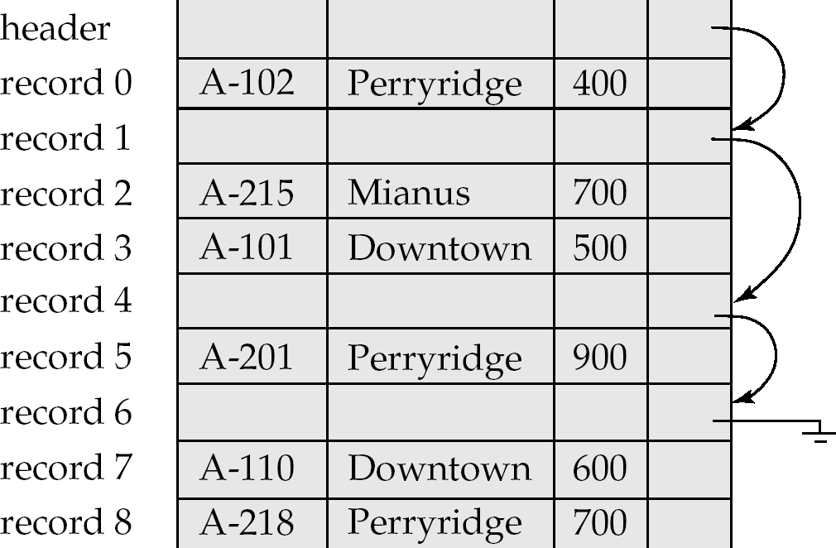
Managing Deletions
Allocate some space at the beginning of the file for a “header”
Allocate some space at the end of each record for a pointer
In the header store the address of the first empty space
Maintain a linked list of the empty spaces using the pointer.
Notes:
Each time you delete, update the tail
Each time you insert, update the head

Slide 18
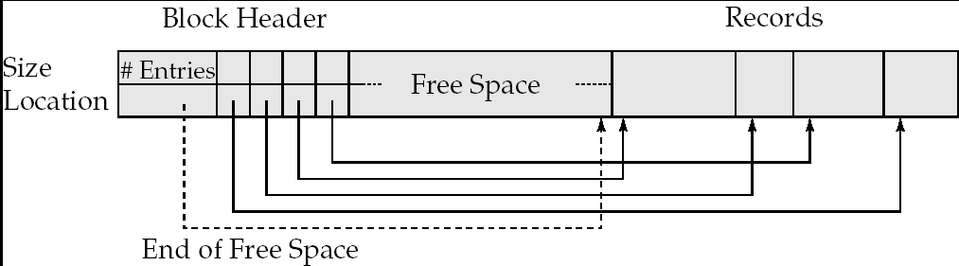
Variable-Length Records
Notes:
As we have seen, you can get variable length records if you have variable length fields.
It can also happen if you end up with records from different tables stored in the same file (this can happen, and can often even be a good thing, as we will discuss later)
With variable length records, you can’t go “40, 80, 120…..” to figure out the record boundaries, so you have to store more information with each record.
This introduces both space and time overhead.
A common structure is shown here.
At the start of each BLOCK, you must add header information.
The header contains 1) the number of records, a pointer to the end of the free space, and a list of (size,location) pairs, one for each record in the block.
The block is filled contiguously, starting from the end.
Later we will see that there are other structure in the database that maintain pointers to records (the most obvious example being indices). Should those pointers point to the record itself, or to its entry in the block header?
Entry in the block header. That way records can be rearranged in the block for tidiness without breaking anything.

Slide 19
What About Records that are Larger than a Block?
Notes:
Allowing records larger than a block would simply reintroduce the whole “crossing the block boundary” problem, and is generally not permitted.
Objects that must be larger than a block (e.g. Blob or varbinary(MAX) types) are usually stored in completely separate special purpose area distinct from the other fields in their record.
Managing this is one of the reasons that Blob type implementations lag behind other data types in some systems (e.g. Access)

Slide 20
Organisation of Records within Files
Heap
Records stored in random order (usually insert order)
Sequential
Records stored in sort order on one field
Hash
Record position computed as a function of the value of a field
Notes:
So we have seen how records are physically placed within individual blocks to maximise time and space efficiency.
But how should the set of records that comprise a table be arranged?
(Note the following discussion is something of an oversimplification, and omits some technical details. A basic understanding of the issues will be enough for this paper and for most DB situations, but if you are interested in the O/S details, I can provide further references.)
Assume for the moment that each table gets its own file. How would you order the records within that file?
Heap
Random
Usually in insert order
Sequential
Sorted
Most likely on the primary key

Slide 21
Insertion
Heap
Any empty space
Sequential
Linear search to find correct position
Hash
Compute hash function
Place record there if possible
Resolve collision if required

Slide 22
Retrieval
Heap
Linear search (possibly through entire file)
Sequential
Binary search
Hash
Compute hash function
Go there
Follow collision resolution path if required

Slide 23
Range Queries
Heap
Requires pre-sorting
Sequential
Directly on file
Hash
Requires pre-sorting

Slide 24
Deletion
Heap
No overhead
Sequential
Must maintain pointer chains
Hash
Must maintain pointer chains

Slide 25
Storage Space
Heap
No wasted space
Sequential
No wasted space
Hash
Requires extra space

Slide 26
File Organisation
 | Heap | Sequential | Hash
Insertion | + | - | 0
Retreival | - | 0 | +
Range | - | + | -
Deletion | + | - | -
Space | + | + | -
Notes:
So which should you use?
It depends on what sort of use your database is going to be put to.
Of course.

Slide 27
Indexing
Caution: Different authors use the terminology of indexing slightly differently
Notes:
Of all the things on that list of “stuff you can do”, the safest is indexing. It is also the one over which you have the most direct and flexible control.
So we will spend more time on it than on any of the others. We will talk about them briefly at the end.
So, make sure you have the concepts clear, and be aware that there may be these conflicts
When discussing indexing, make sure that everyone is talking about the same thing.
Primary Index: On a primary key. If dense, will be 1-1 entry to record relationship. Can be sparse if file is ordered on the primary key, having one index entry for each block. These are guaranteed to be unique values, as each record has a unique value on this field.
Clustering Index: On the field that determines the sort order of the file, but need not be primary (and therefore need not be unique). Retrieval therefore not guaranteed to be 1-1, and file must be traversed to change in field value. Has an entry for every distinct value of the field, although not necessarily for every record (if there are duplicates, there will be fewer values than records). Does this make it sparse or dense?
Secondary index: On a non-primary key and non-sort-order key. Must therefore have one entry for each record (i.e. it is dense)
Primary: One entry for each block
Clustering: One entry for each value
Secondary: One entry for each record if the index is a candidate key, or each block of pointers to records having the same value, otherwise

Slide 28
Searching
Name | Capitol | Population | Bird | Flower | Insect
Rhode Island | Providence | 1,048,319 | Rhode Island Red | Violet | --
Arizona | Phoenix | 5,130,632 | Cactus Wren | Saguaro Cactus Blossom | Swallowtail butterfly
Vermont | Montpelier | 608,827 | Hermit Thrush | Red Clover | Honey bee
Hawaii | Honolulu | 1,211,537 | Nene | Hibiscus | --
Alaska | Juneau | 626,932 | Willow Ptarmigan | Forget Me Not | Skimmer dragonfly
California | Sacramento | 33,871,648 | California Valley Quial | California Poppy | Dogface butterfly
Kansas | Topeka | 2,688,418 | Western Meadowlark | Sunflower | Honey bee
Idaho | Boise | 1,293,953 | Mountain Bluebird | Syringa | Monarch butterfly
Alabama | Montgomery | 4,447,100 | Yellow Hammer | Camellia | Monarch butterfly
New york | Albany | 18,976,457 | Bluebird | Rose | Ladybug
Arkansas | Little Rock | 2,675,400 | Mockingbird | Apple Blossom | Honey bee
………
Notes:
Let’s assume that for some reason, you have to deal with this database about the United States.
There are exactly 50 individual states in the U.S., each with its own capitol, state bird, state flower, state insect and, of course, population.
You have a sort of ordinary table of information for a state record, and it is stored in a heap (that is unordered).
The first bit of the table looks like this…
Assuming that the table is in random order on disk, what is the algorithm required to find a particular record, say, Hawaii?
Linear search – you would have to start at the beginning and look at every record until you found Hawaii in the Name field, or you reached the end of the records. On a bad day, Hawaii might be record 50 and you would have to look at the whole table
If the table was large, you would pull in an awful lot of data from disk before you found what you wanted
(Note, this example only has 50 records in it for the sake of clarity; always keep in mind though, that production databases can have millions and millions of records.)
If you think about it, though, to find the Hawaii record, you don’t need the whole record, you only need the name field.
Imagine instead that we had a structure like this:

Slide 29
Searching
Name
Alabama
Alaska
Arizona
Arkansas
California
….
Hawaii
Idaho
….
Kansas
….
New york
….
Rhode Island
….
Vermont
Name | Capitol | Population | Bird | Flower | Insect
Rhode Island | Providence | 1,048,319 | Rhode Island Red | Violet | --
Arizona | Phoenix | 5,130,632 | Cactus Wren | Saguaro Cactus Blossom | Swallowtail butterfly
Vermont | Montpelier | 608,827 | Hermit Thrush | Red Clover | Honey bee
Hawaii | Honolulu | 1,211,537 | Nene | Hibiscus | --
Alaska | Juneau | 626,932 | Willow Ptarmigan | Forget Me Not | Skimmer dragonfly
California | Sacramento | 33,871,648 | California Valley Quial | California Poppy | Dogface butterfly
Kansas | Topeka | 2,688,418 | Western Meadowlark | Sunflower | Honey bee
Idaho | Boise | 1,293,953 | Mountain Bluebird | Syringa | Monarch butterfly
Alabama | Montgomery | 4,447,100 | Yellow Hammer | Camellia | Monarch butterfly
New york | Albany | 18,976,457 | Bluebird | Rose | Ladybug
Arkansas | Little Rock | 2,675,400 | Mockingbird | Apple Blossom | Honey bee
………
Notes:
The ellipsis indicate fields that are not displayed
This structure has all 50 state names, in alphabetical order
For each one, it has a pointer to the address of disk of the associated record.
To find the record for, say, Hawaii, you look up Hawaii in this little name table, and have directly its address on disk
No unused bits, other than the names are pulled in

Slide 30
Searching
Name
Alabama
Alaska
Arizona
Arkansas
California
….
Hawaii
Idaho
….
Kansas
….
New york
….
Rhode Island
….
Vermont
Can all be held in main memory
Can use a binary search algorithm
Worst case log₂(n)
Index
Notes:
So instead of searching the whole database, we just search this little table, which is going to be much faster for a number of reasons
Main memory: No matter how many columns there are in the database, this table will have only the search key
Binary search. Usual phone book analogy and explanation of O(log n) complexity.
This little table – a sorted set of search key values with pointers to record addresses -- is called an index
When you create a table in MSSQL, it automatically makes an index on the primary key (we’ll talk later about other indices) and uses it in queries to speed up retrieval.

Slide 31
Index
Name | Capitol | Population | Bird | Flower | Insect
Alabama | Montgomery | 4,447,100 | Yellow Hammer | Camellia | Monarch butterfly
Alaska | Juneau | 626,932 | Willow Ptarmigan | Forget Me Not | Skimmer dragonfly
Arizona | Phoenix | 5,130,632 | Cactus Wren | Saguaro Cactus Blossom | Swallowtail butterfly
Arkansas | Little Rock | 2,675,400 | Mockingbird | Apple Blossom | Honey bee
California | Sacramento | 33,871,648 | California Valley Quial | California Poppy | Dogface butterfly
….
Hawaii | Honolulu | 1,211,537 | Nene | Hibiscus | --
Idaho | Boise | 1,293,953 | Mountain Bluebird | Syringa | Monarch butterfly
….
Kansas | Topeka | 2,688,418 | Western Meadowlark | Sunflower | Honey bee
….
New york | Albany | 18,976,457 | Bluebird | Rose | Ladybug
….
Rhode Island | Providence | 1,048,319 | Rhode Island Red | Violet | --
….
Vermont | Montpelier | 608,827 | Hermit Thrush | Red Clover | Honey bee
Alabama
California
Florida
Iowa
Montana
Pennsylvania
Vermont
Notes:
But what if instead of 50 records, you have millions.
For example, the Internal Revenue Service in the United States has a database with 400,000,000 records.
Even a single field index (on SSN, say) would get huge.
It would spread across blocks on disk and be slow to process.
So we would like to make our index smaller.
One way to do this is to keep only some of the values, like this.
How can you speed up access to the table with this kind of index?
How can you even find Hawaii, since it’s not in the index?
Ponder, ponder….
What if the database table itself is stored sorted.
Each value in the index points to its guy. Alabama to Alabama, California to California, Montana to Montana, etc.
What’s the algorithm for retrieval now?
Find the value in the index that’s after you in the alphabet
Use the one right before him
Go where it points
Search the table until you find what you’re looking for, or hit the next “pointed to” entry (in which case it’s not in the database)

Slide 32
Index
Dense
Index contains an entry for every record in the database
Sparse
Index contains entries for only some of the records in the database
Notes:
So we’ve seen these two approaches

Slide 33
Dense or Sparse?
Sparse index requires more rows to be fetched from the database.
Dense index requires more space for index and, consequently, longer search time to find index entry.
Notes:
Putting together the sparse/dense distinction with what you know about how magnetic disks work, can you come up with a good scheme?

Slide 34
Hint
Remember that the bottleneck in disk access is the seek (finding the block), not the read (transferring the contents)

Slide 35
Effective Indexing
Alabama | Montgomery | 4,447,100 | Yellow Hammer | Camellia | Monarch butterfly
Alaska | Juneau | 626,932 | Willow Ptarmigan | Forget Me Not | Skimmer dragonfly
Arizona | Phoenix | 5,130,632 | Cactus Wren | Saguaro Cactus Blossom | Swallowtail butterfly
Arkansas | Little Rock | 2,675,400 | Mockingbird | Apple Blossom | Honey bee
Block 1
Alabama
California
Idaho
New York
California | Sacramento | 33,871,648 | California Valley Quial | California Poppy | Dogface butterfly
….
Hawaii | Honolulu | 1,211,537 | Nene | Hibiscus | --
Block 2
Idaho | Boise | 1,293,953 | Mountain Bluebird | Syringa | Monarch butterfly
….
Kansas | Topeka | 2,688,418 | Western Meadowlark | Sunflower | Honey bee
….
Block 3
New york | Albany | 18,976,457 | Bluebird | Rose | Ladybug
….
Rhode Island | Providence | 1,048,319 | Rhode Island Red | Violet | --
Block 4
Notes:
Choose your sparse index entries so that each one points to the record at the start of a block of memory.
It thus takes you only one seek to get any record in the database.
(Note those blocks of memory are all the same size; just having trouble getting Powerpoint to cooperate

Slide 36
Types of Index
Assume the table is sorted.
Database and index are in the same sort order
Primary Index:
Index is on primary or candidate key
Will be only one record for each index entry
Clustered index
Index is on a non-candidate key
May be multiple records for a single index entry
Notes:
The first two:
Think a bit about how the implementation and algorithm are different for the clustered index as opposed to the primary.

Slide 37
Types of Index
What about the other (non sort key) fields?
If we often do queries based on another field, we can gain efficiency by indexing on that field.
This is called a “secondary index”
Notes:
The third one
Can we index on, say State Capitol?
Sure.

Slide 38
Secondary Index
Albany
….
Boise
…..
Honolulu
….
Juneau
…
Name | Capitol | Population | Bird | Flower | Insect
Alabama | Montgomery | 4,447,100 | Yellow Hammer | Camellia | Monarch butterfly
Alaska | Juneau | 626,932 | Willow Ptarmigan | Forget Me Not | Skimmer dragonfly
Arizona | Phoenix | 5,130,632 | Cactus Wren | Saguaro Cactus Blossom | Swallowtail butterfly
Arkansas | Little Rock | 2,675,400 | Mockingbird | Apple Blossom | Honey bee
California | Sacramento | 33,871,648 | California Valley Quial | California Poppy | Dogface butterfly
….
Hawaii | Honolulu | 1,211,537 | Nene | Hibiscus | --
Idaho | Boise | 1,293,953 | Mountain Bluebird | Syringa | Monarch butterfly
….
Kansas | Topeka | 2,688,418 | Western Meadowlark | Sunflower | Honey bee
….
New york | Albany | 18,976,457 | Bluebird | Rose | Ladybug
….
Rhode Island | Providence | 1,048,319 | Rhode Island Red | Violet | --
….
Vermont | Montpelier | 608,827 | Hermit Thrush | Red Clover | Honey bee
Notes:
Note the ellipses in the index.
Is a secondary index sparse or dense?
Must be dense. Since the table is not sorted on the index key (by definition, since it is secondary) you can’t do “find and follow”

Slide 39
Secondary Index
Since a secondary index is on a non-key field, there may be duplicate index values.
In this case, one index value ⬄ one database record won’t work.
What can be done?

Slide 40
Secondary Index
Name | Capitol | Population | Bird | Flower | Insect
Rhode Island | Providence | 1,048,319 | Rhode Island Red | Violet | --
Arizona | Phoenix | 5,130,632 | Cactus Wren | Saguaro Cactus Blossom | Swallowtail butterfly
Vermont | Montpelier | 608,827 | Hermit Thrush | Red Clover | Honey bee
Hawaii | Honolulu | 1,211,537 | Nene | Hibiscus | --
Alaska | Juneau | 626,932 | Willow Ptarmigan | Forget Me Not | Skimmer dragonfly
California | Sacramento | 33,871,648 | California Valley Quial | California Poppy | Dogface butterfly
Kansas | Topeka | 2,688,418 | Western Meadowlark | Sunflower | Honey bee
Idaho | Boise | 1,293,953 | Mountain Bluebird | Syringa | Monarch butterfly
Alabama | Montgomery | 4,447,100 | Yellow Hammer | Camellia | Monarch butterfly
New york | Albany | 18,976,457 | Bluebird | Rose | Ladybug
Arkansas | Little Rock | 2,675,400 | Mockingbird | Apple Blossom | Honey bee
………
Notes:
For example, what if we want to index State Insect.
There are multiple occurrences of Honey Bee and Monarch Butterfly

Slide 41
Secondary Index
Name | Capitol | Population
Alabama | Montgomery | 4,447,100
Alaska | Juneau | 626,932
Arizona | Phoenix | 5,130,632
Arkansas | Little Rock | 2,675,400
California | Sacramento | 33,871,648
….
Hawaii | Honolulu | 1,211,537
Idaho | Boise | 1,293,953
….
Kansas | Topeka | 2,688,418
….
New york | Albany | 18,976,457
….
Rhode Island | Providence | 1,048,319
….
Vermont | Montpelier | 608,827
Ant
Black Beetle
.....
Honey Bee
......
Monarch Butterfly
Praying Mantis
Notes:
You keep a “bucket” of pointers to all the records with the index entry.
The index points to the bucket
The buckets are just linked lists

Slide 42
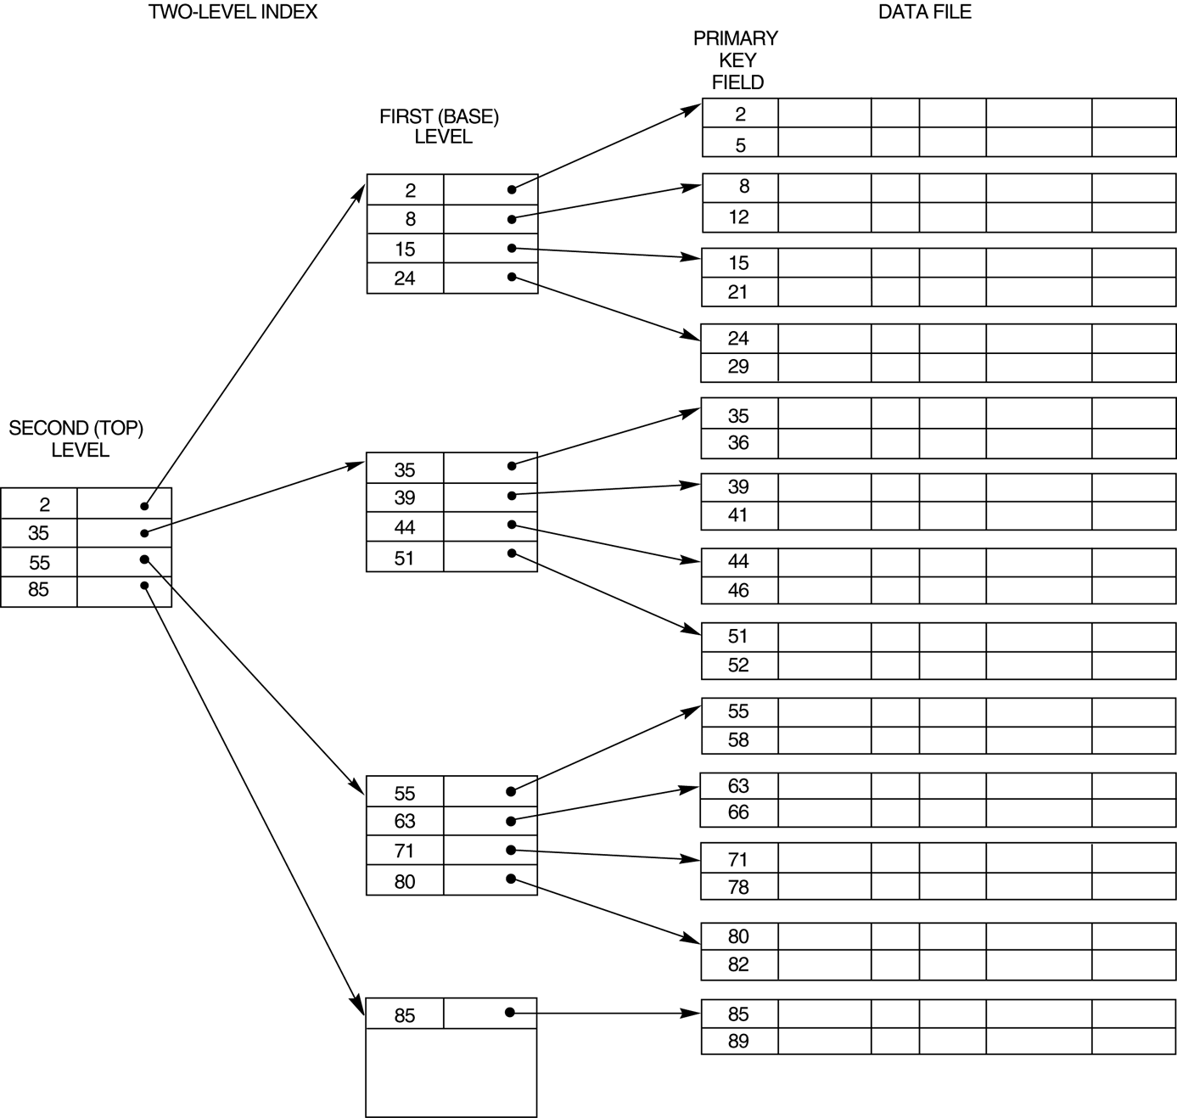
Multilevel Index
Notes:
But what if your index gets so big that, even sparse, it’s too big to fit in main memory?
Index your index.

Slide 43
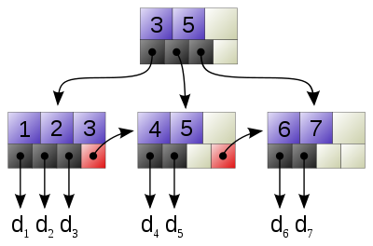
Structure of Indices
Name
Alabama
Alaska
Arizona
Arkansas
California
….
Hawaii
Idaho
….
Kansas
….
New york
….
Rhode Island
….
Vermont
Notes:
Remember that when we first saw this index, we said that it was fast to search because it was sorted.
Like using a phone book, we used a binary search, which allows us to eliminate half the index, then half of the remaining, then half of the remaining, and so on.
In practice, we can get even better performance with indices.
Imagine that instead of dividing the index in half and eliminating one half, you could, in one step, divide it in thirds and eliminate 2/3. Or divide it in fourths and eliminate ¾. That would make the search even faster.
This is achieved by storing the index not as, essentially, an array, like we see here, but in a hierarchical structure called a B+ tree.
Imagine we have indexed an IDENTITY primary key. The only values are 1 to 7.
The top node, the root, has two values in it (3 & 5) that divide the data set up into approximate 1/3
That node has pointers to three children k<=3, 3<k<=5, k>5.
You look in the root node, compare the value you’re hunting for to the values you find there, and follow the pointer to the correct child.

Slide 44
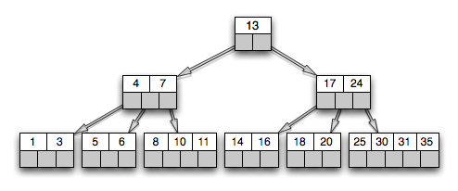
B+ Tree
Notes:
B+ trees are complicated data structures that grow and change as more records are inserted according to elegant algorithms.
As the data set grows, the B+ tree gets wider more quickly than it gets taller, thus getting to a leaf (where the pointer to the record is) remains fast.
A typical “fan-out” for a production B+ tree is more than 100, allowing you to eliminate a large proportion of the unwanted records at each step down the tree.
The details of the management of B+ tree is out of scope for this paper, but let me know if you want more detailed references.

Slide 45
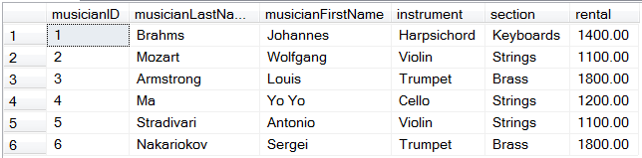
Bitmap Index
Brass | Keyboards | Percussion | Strings
0 | 1 | 0 | 0
0 | 0 | 0 | 1
1 | 0 | 0 | 0
0 | 0 | 0 | 1
0 | 0 | 0 | 1
1 | 0 | 0 | 0
Notes:
The types of indices we have been discussing are most efficient when the index key has a wide range of values, and few occurrences per value, as this maximises the selectivity of the index, minimising the number of records to be returned, and hence, the number of disk accesses
Having an index on, say, gender isn’t really worth the effort, because you have to deal with such a large record set anyway.
The bitmap index, however, is another kind of index that works best on keys that have a small set of values.
This kind of index is stored as a simple table, like a two-dimensional array
Each cell holds a single bit
Each row corresponds to a row in the table to which the index is bound
Each column corresponds to a single possible value of the attribute being indexed
As shown in the figure

Slide 46
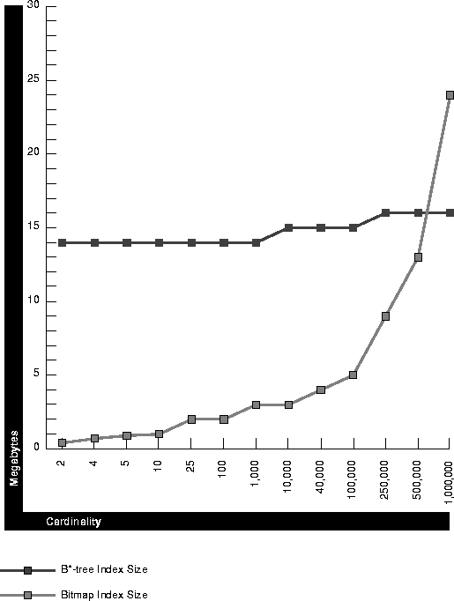
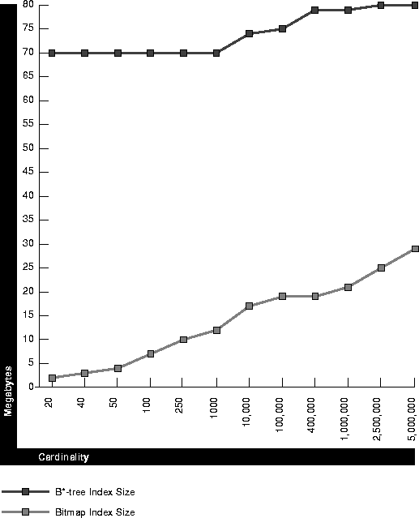
Bitmap Index
Advantages
Size
Notes:
A B-tree index must contain all of the key values for every record (and that’s just the lead nodes). If keys are large, then the tree is large.
However, a bitmap index uses only one bit to represent each value.
In addition, the bitmap structure is highly suitable for compression
Thus bitmap indexes are much smaller than B-trees
This advantage is more pronounced the lower the cardinality of the indexed attribute
The advantage is more pronounced for larger databases (1,000,000 rows on the left; 5,000,000 on the right)

Slide 47
Bitmap Index
Advantages
Computation Speed
staffID | fName | lName | Position | Salary | Branch No
SL21 | John | Smith | Manager | 42000 | B5
SG37 | Ann | Jones | Assistant | 24000 | B3
SG14 | David | Howe | Assistant | 22000 | B3
SA9 | Mary | Leeson | Supervisor | 67000 | B7
SG5 | Susan | Beech | Manager | 53000 | B3
SL41 | Julie | Arbuthnot | Assistant | 17000 | B5
Manager | Assistant | Supervisor
1 | 0 | 0
0 | 1 | 0
0 | 1 | 0
0 | 0 | 1
1 | 0 | 0
0 | 1 | 0
B3 | B5 | B7
0 | 1 | 0
1 | 0 | 0
1 | 0 | 0
0 | 0 | 1
1 | 0 | 0
0 | 1 | 0
Notes:
Certain types of operations are especially efficient when you have bitmapped indices
For example, you can do counts quite easily from the index alone, without accessing the database. Just sum the corresponding column.
And you can also do certain costly joins very cheaply
Imagine we have this table and we want to select supervisors from branch B3
With only traditional indices this requires grabbing all the records and performing equality comparison on each pair of supervisor and branch fields
With the bitmap indices, however, you just.....do a bitwise AND on the two columns

Slide 48
Bitmap Index
Disadvantages
Very high overhead to maintain
Not available in SQL Server
Notes:
A modification to a bitmap index requires a great deal more work on behalf of the system than a modification to a b-tree index.

Slide 49
How are Indexes Used
Automatic
For each query, the DBMS determines if there is a relevant index.
It then determines whether using the index will speed up the query processing.
Notes:
So you don’t have to do anything
We will look more closely at this “system decides what to do” business when we discuss query processing and optimisation next time.

Slide 50
How are Indexes Created
All Primary Key fields are automatically indexed.
You can create your own indices using the CREATE INDEX command
Notes:
And, to allow a sparse index on PK, the table is sorted on PK

Slide 51
How to Create Indexes
CREATE [ UNIQUE ] [ CLUSTERED | NONCLUSTERED ] INDEX index_name
ON <object> ( column [ ASC | DESC ] [ ,...n ] )
[ INCLUDE ( column_name [ ,...n ] ) ]
[ WHERE <filter_predicate> ]
[ WITH ( <relational_index_option> [ ,...n ] ) ]
[ ON { partition_scheme_name ( column_name ) | filegroup_name | default } ]
Notes:
The syntax of CREATE INDEX is complex; we will see it in practical
Note the “clustered” option. Remember what that means?
A clustered index is on a field that is not the primary key, but that is a sort key.
Because the assumption is that the table is sorted on that key, the index can be sparse.
What, therefore, do you think SQL Server does to a table if you create a clustered index on it? (Sorts it)
How many clustered indices can you have on a single table? (one)
SQL Server 2008 allows up to 249 non-clustered indices on each table

Slide 52
Multi-Column Index
Note that indexes can be made on more than one column.
The index entry is then a combination of values on the involved columns.
Notes:
Why would you do this?
If you often sort, join or filter on a multi-column comparison

Slide 53
Index Issues
Indexes speed retrieval.
What impact do they have on insertion, deletion and update?
Indexes take up space
So index only those fields that will benefit from being indexed.
Notes:
You’ve got a nice sparse clustered index with the value of the record at the start of a block.
You insert a new record, and the guy at the start of the block changes. What happens to your index? It has to be rebuilt completely.
Same with deletion, and update on variable length fields.
So it’s a tradeoff
Indexes take up space. Eventually if you index enough columns, you might as well be working with the whole table.

Slide 54
What to Index
Fine tuning indexes requires a detailed inspection of queries and performance.
Notes:
We will look at this in practical
But there are some general guidelines

Slide 55
What to Index
General Guidelines
Every table should have at least one primary or clustered index on the most common search key.
Concentrate indexes on tables that are searched often and modified rarely.
Indexes should be considered on all columns that are frequently accessed by the WHERE, ORDER BY, GROUP BY, TOP, and DISTINCT clauses.
Notes:
We will look at this in practical
There are some general guidelines

Slide 56
What to Index
General Guidelines
Create nonclustered indexes on columns that are frequently used in join conditions in queries
Avoid indexing a column with few unique data values. The record set produced will be so large that little benefit is gained.
Avoid indexing small tables. The search efficiency gains will not offset the overhead.
Notes:
We will look at this in practical
There are some general guidelines

Slide 57
Other Modifications
Distributing tables physically
Tables can be partitioned horizontally (row sets) or vertically (column sets)
Sets that are usually accessed together can be placed together on disk to minimise I/O
Notes:
Consider vertical partitioning carefully, though.
A vertical partitioning requires duplication of the primary key for each row
It also requires join operations to put the table back together again

Slide 58
Other Modifications
Storing derived data
Values that are regularly computed by calculations of attributes can be stored precomputed in the database as an additional attribute
Notes:
Upside: No computations required
Downside: Update anomalies now possible if input values change and derived values are not updated.

Slide 59
Other Modifications
Combining tables
One-to-one relationships can be collapsed into a single table
Notes:
Advantage: no join when both fields required
Disadvantage: Slower when only one is required, because the records are bigger
To decide? Obviously must have very detailed knowledge of the database actual, not theoretical, usage.

Slide 60
Other Modifications
Denormalisation
Third-normal form tables can be combined by reproducing columns as required (introducing redundancy)
Notes:
Remember how we took owner out of the dog show table?
Now our data were protected, but to get the owner requires a join
So, to eliminate the join, we can put it back
This of course introduces all the problems that normalisation solved for us.
Very risky, and going out of fashion rapidly as hardware and DBMS algorithms improve

Slide 61
Other Modifications
Duplication
Notes:
If user competition for access is hurting response times, and you have tried everything else you can possibly think of, you can always make multiple copies of the database, and direct different users or applications to different copies
The hideous downside of this should be obvious
To make it slightly less awful, you can duplicate only the most popular parts of the database.

Slide 62
Exercises
Notes:
Our discussion today has been focusing on principles, concepts and theory.
So will our exercises.
Remember that we will have a chance to see these things in action later in the term.

